Slide 2

Project MentorHub Communication Subsystem
Bao Ly | 20.06.2024

Slide 3

Agenda
Overview
Use Case Diagram
UI Design – Database Entity
Q&A

Slide 4
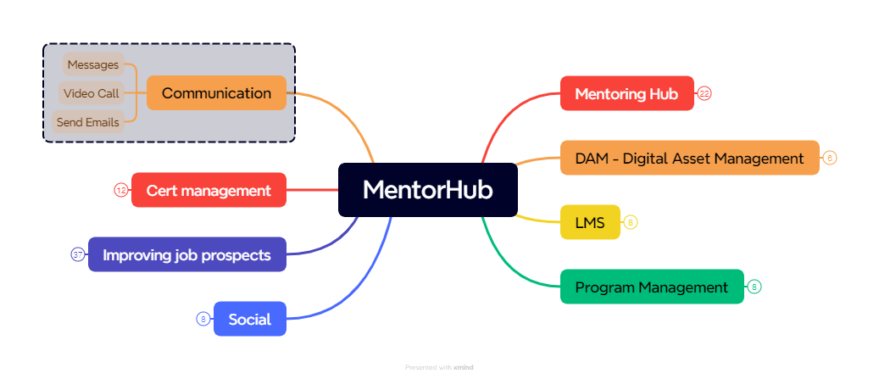
Overview – Mentor Hub

Slide 5
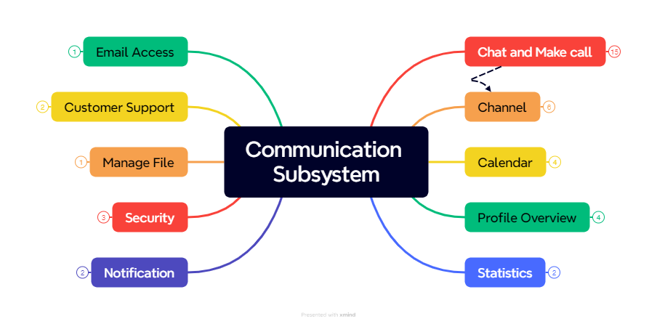
Overview – Mentor Hub

Slide 6
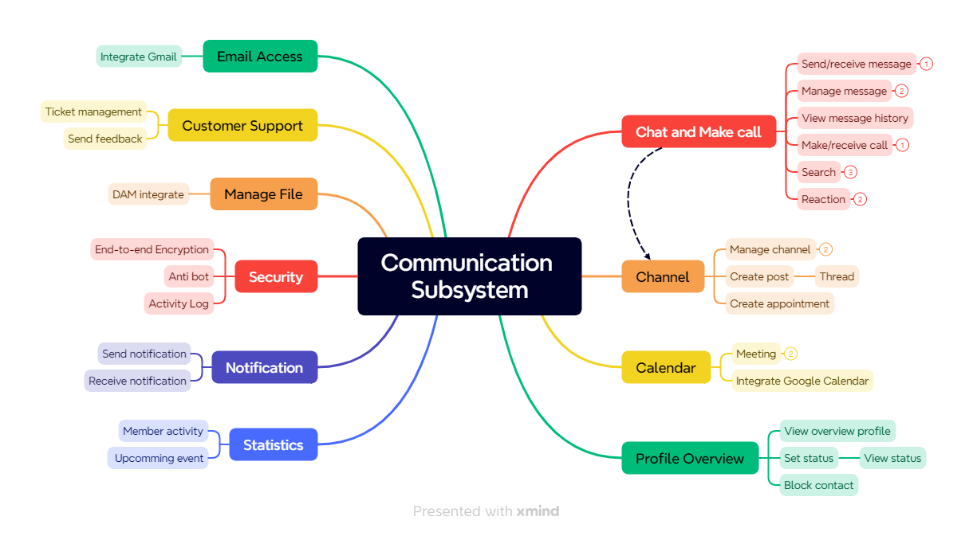
Overview – Communication Subsystem

Slide 7
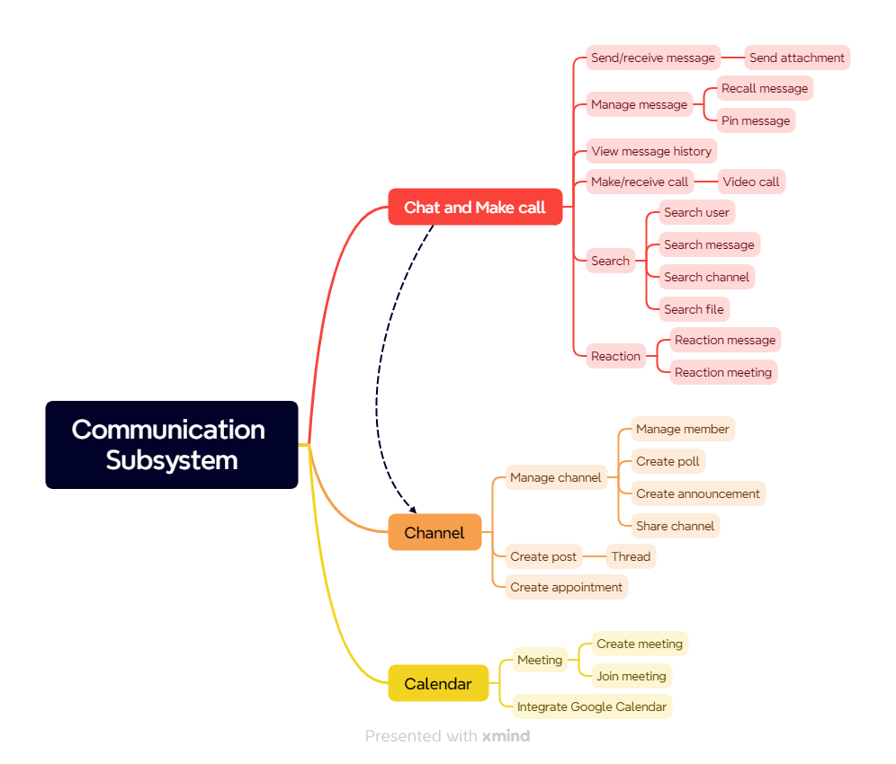
Overview – Communication Subsystem

Slide 8
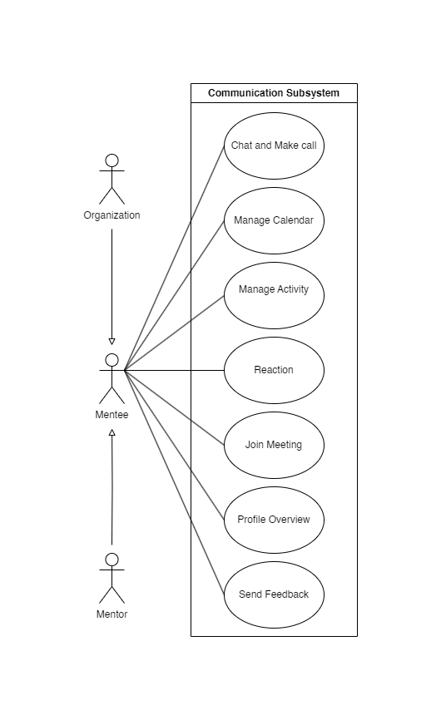
Use Case Diagram
4 actors:
Mentor
Mentee
Organization
System

Slide 9
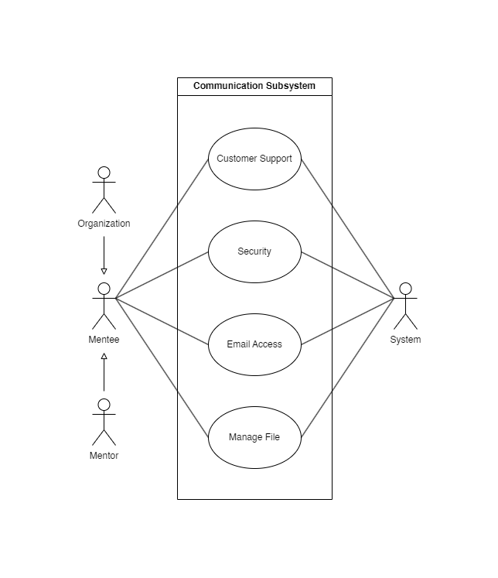
Use Case Diagram

Slide 10
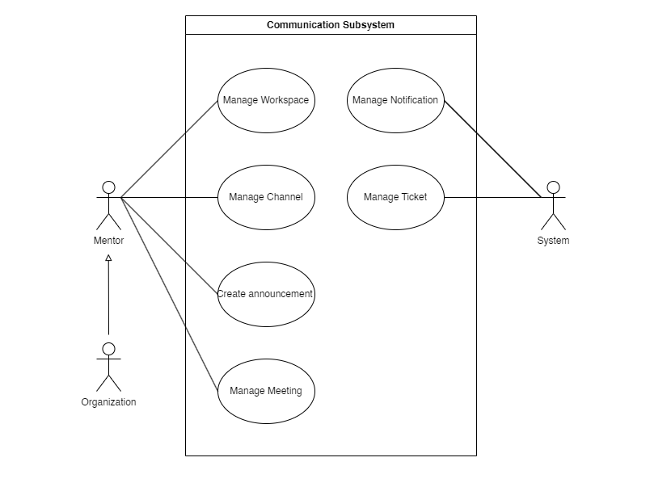
Use Case Diagram

Slide 11
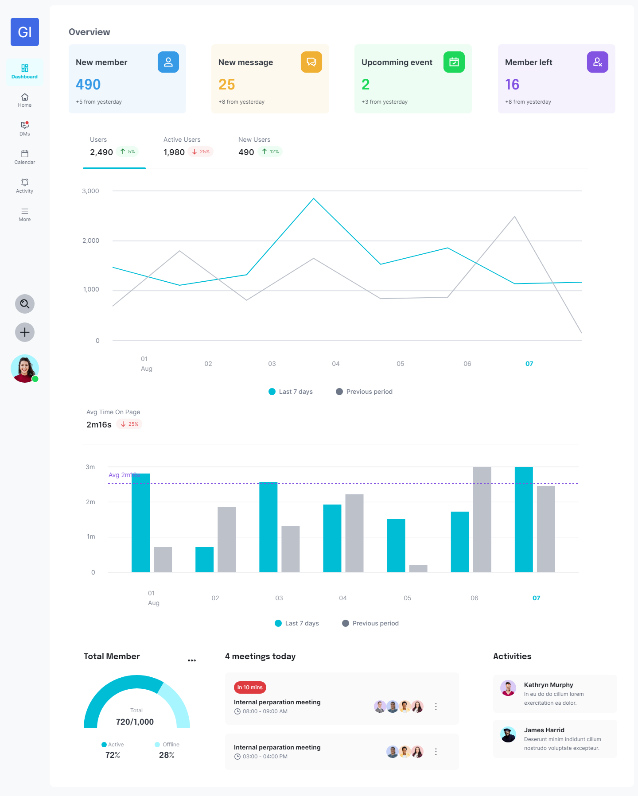
UI Design – Dashboard

Slide 12
UI Design – Dashboard

Slide 13
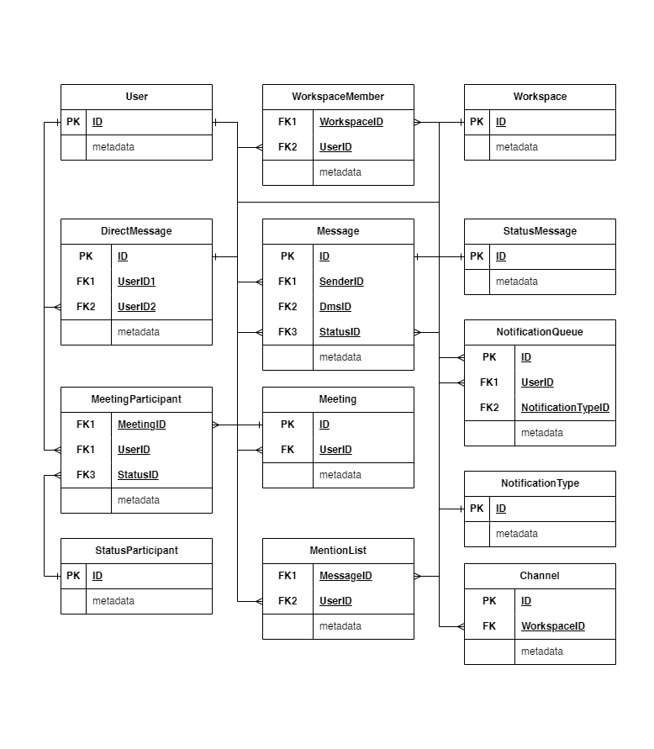
Database Entity – Dashboard

Slide 14
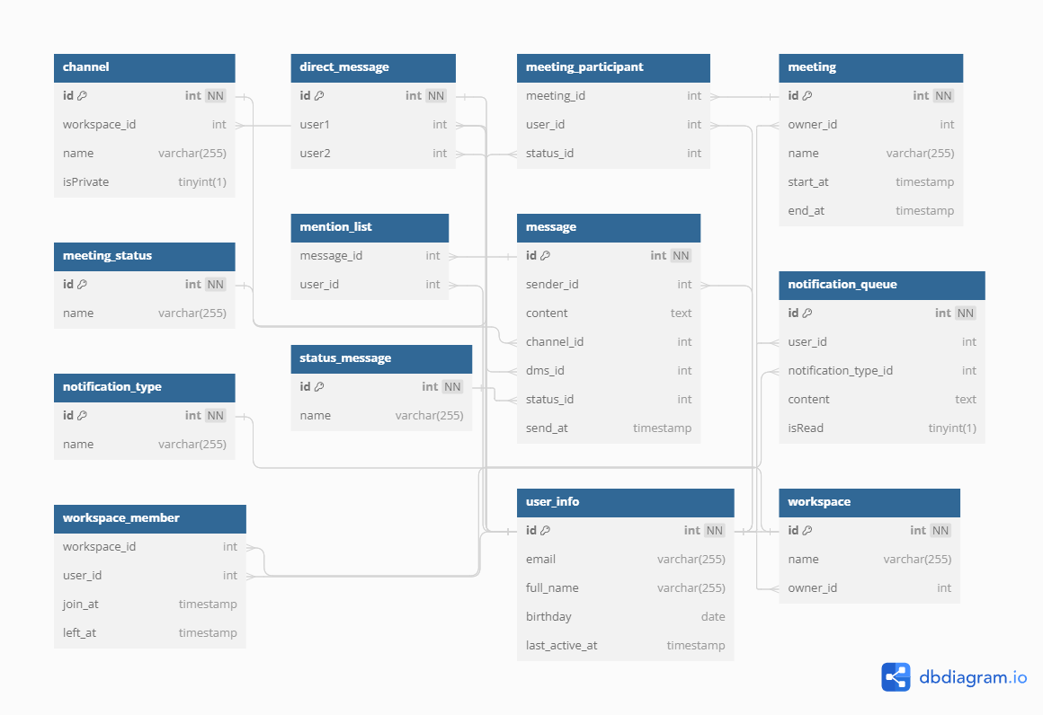
Database Design – Dashboard

Slide 15
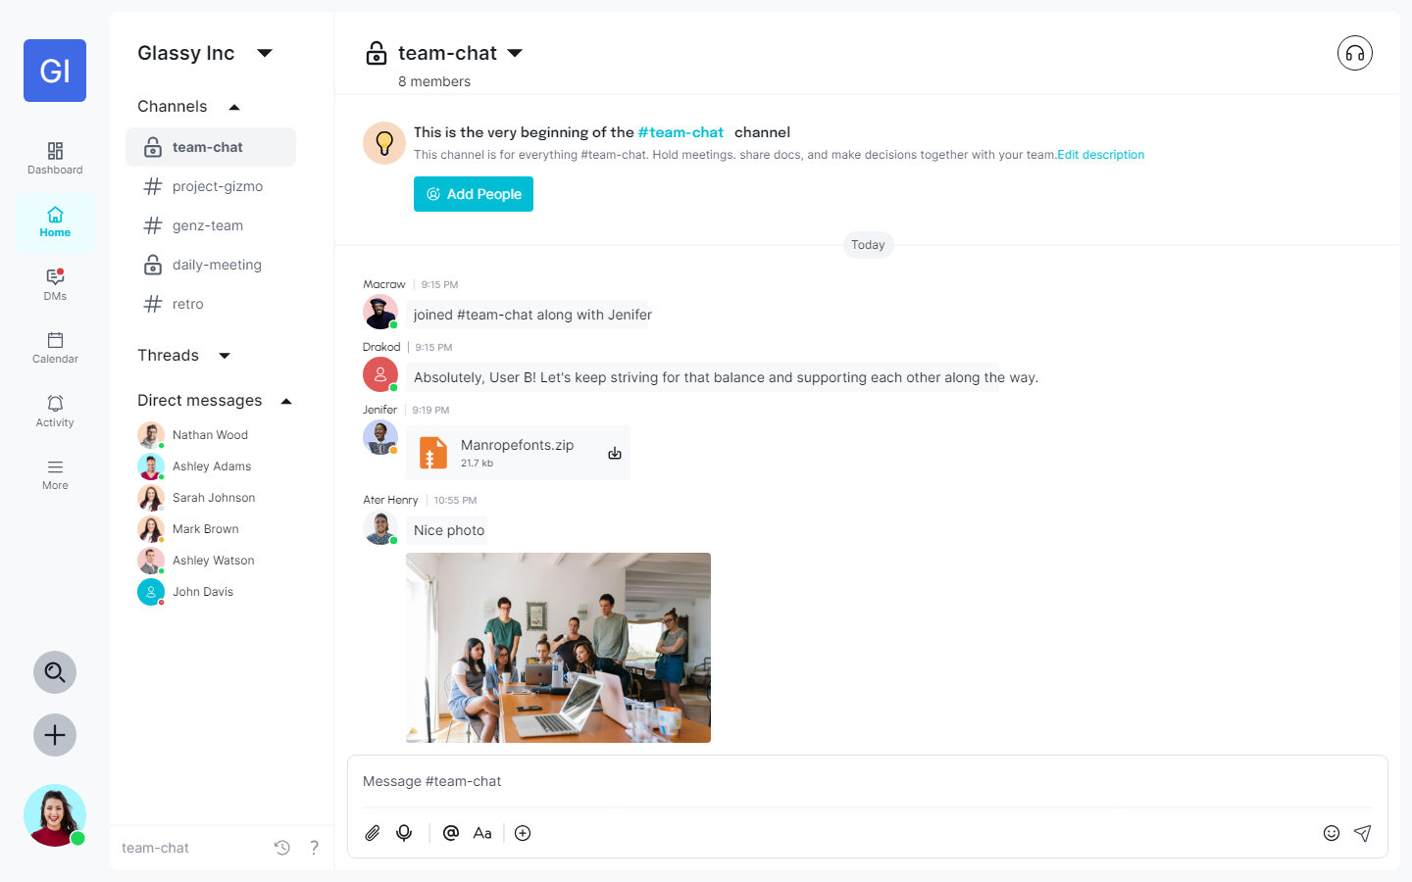
UI Design – Home

Slide 16
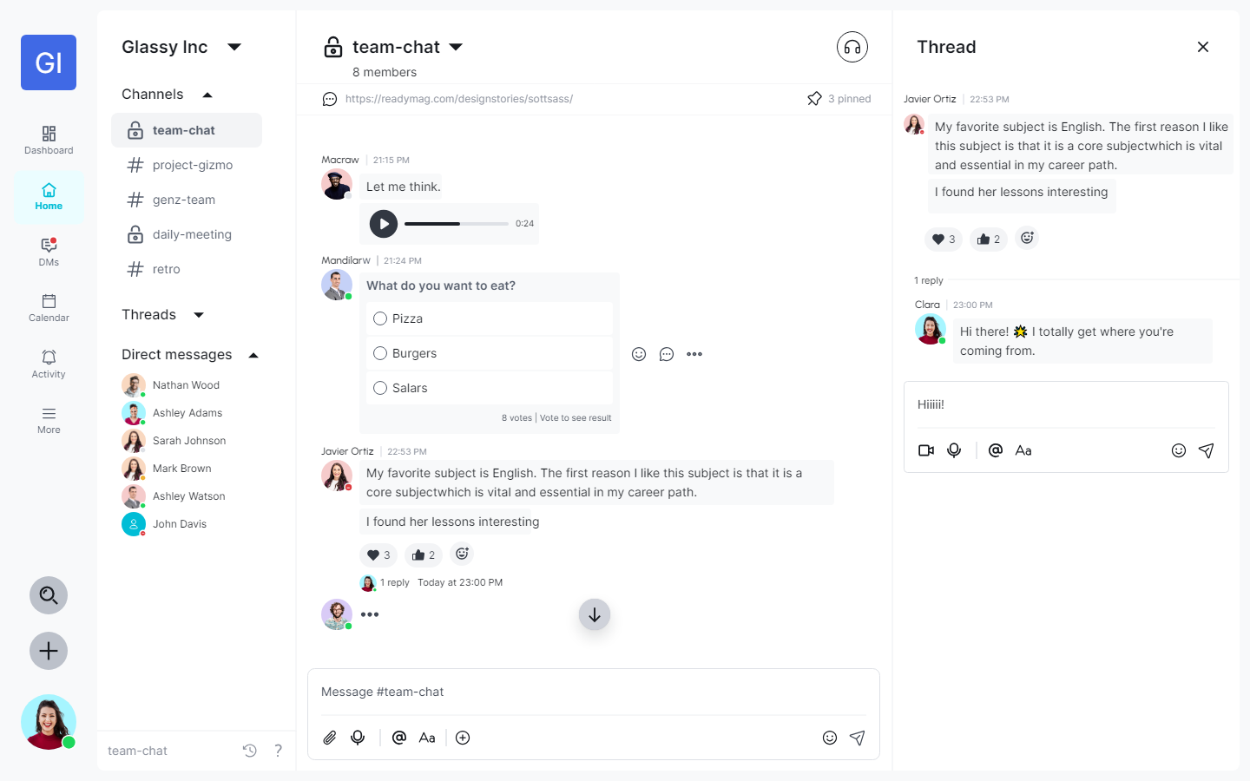
UI Design – Home

Slide 17
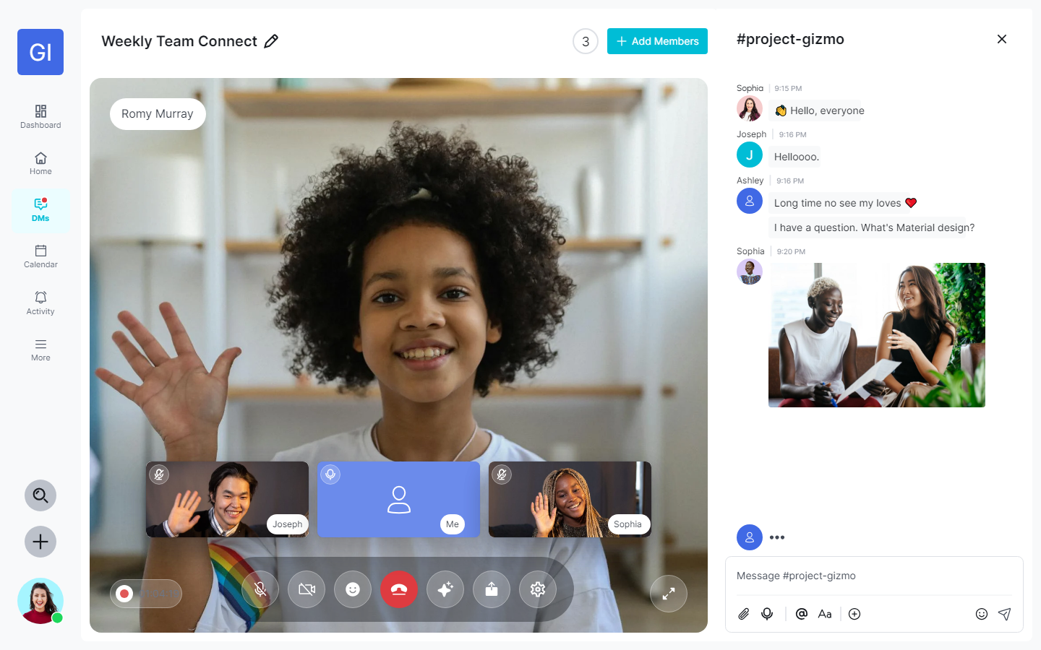
UI Design – Video Call

Slide 18
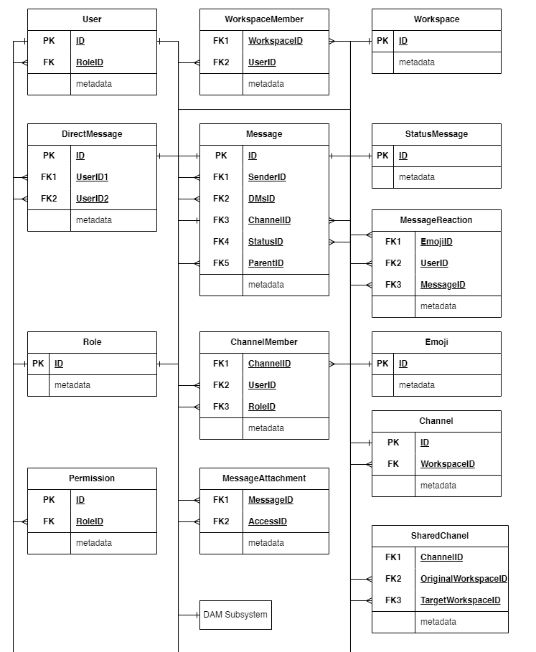
Database Entity – Home

Slide 19

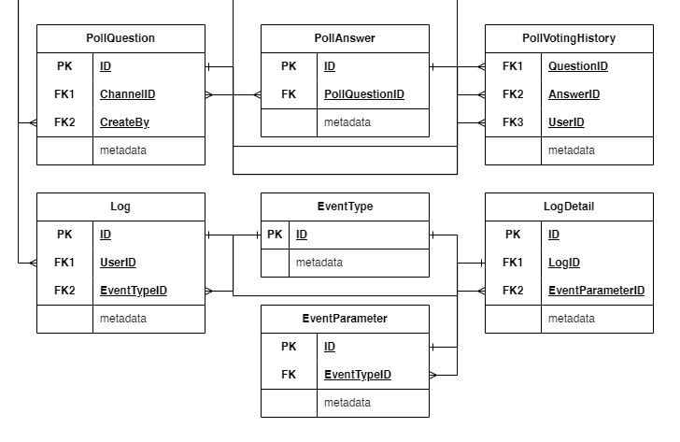
Database Entity – Home

Slide 20
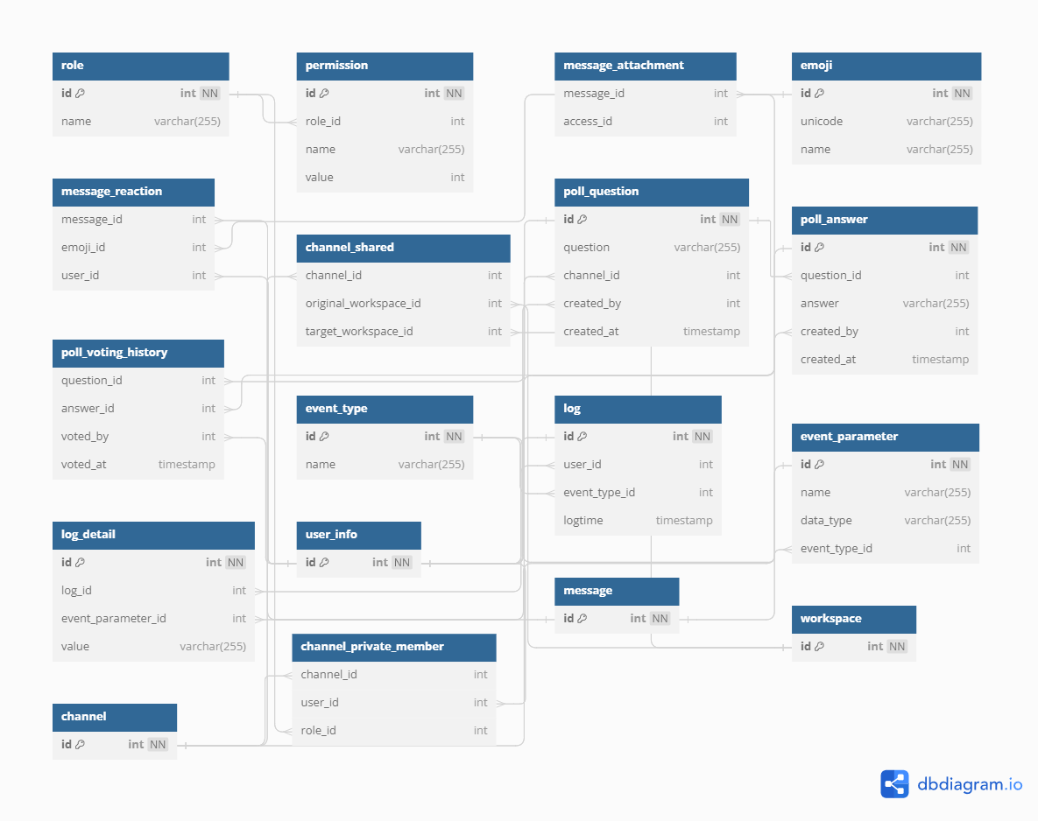
Database Design – Home

Slide 21
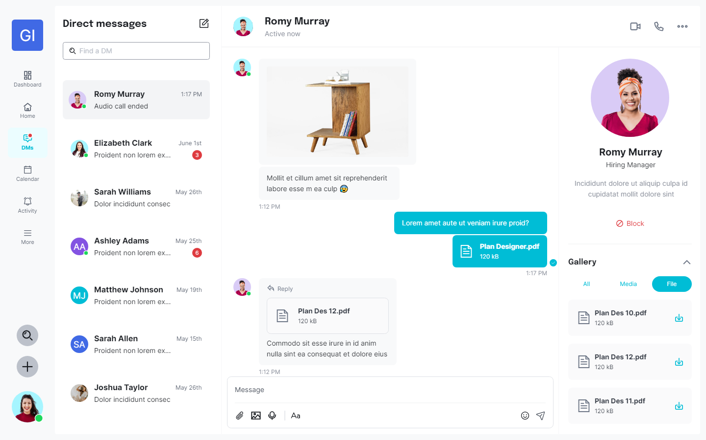
UI Design – Direct Messages

Slide 22
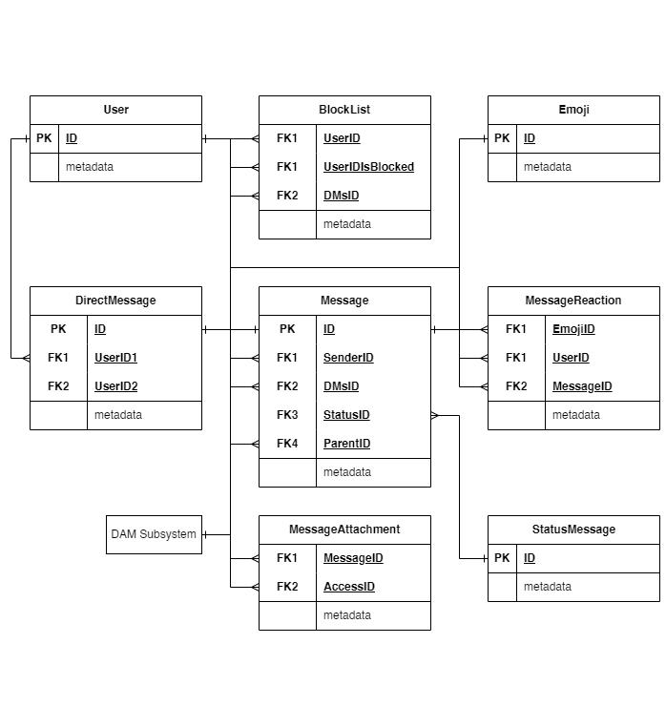
Database Entity – Direct Messages

Slide 23
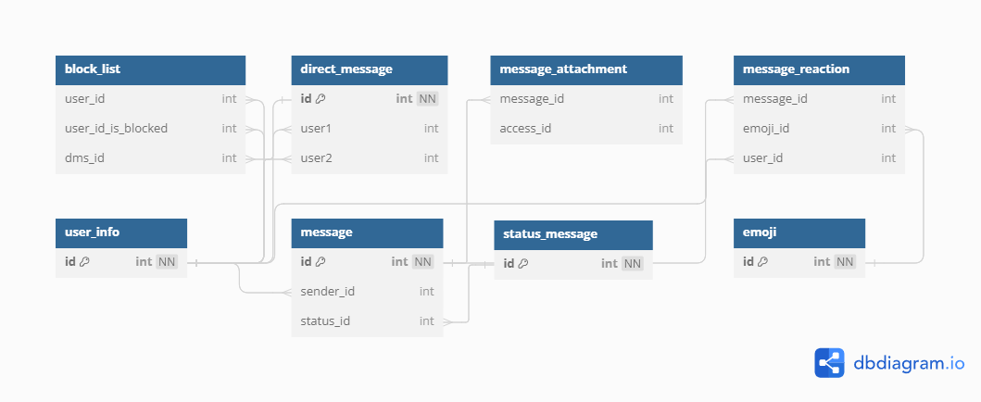
Database Design – Direct Messages

Slide 24
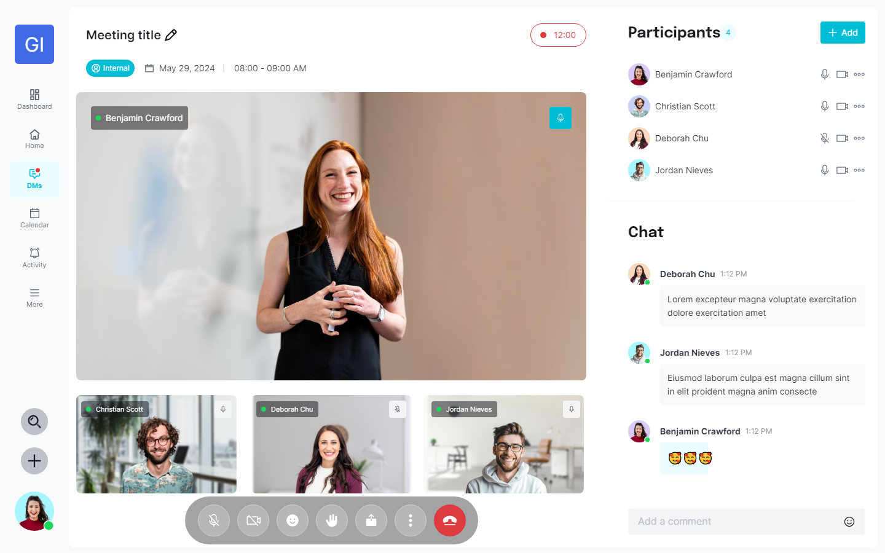
UI Design – Meeting

Slide 25
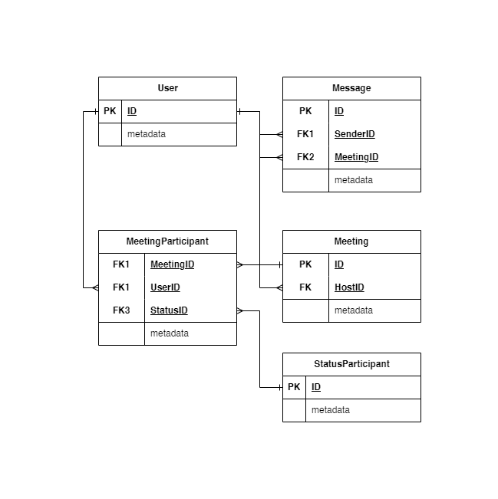
Database Entity – Meeting

Slide 26
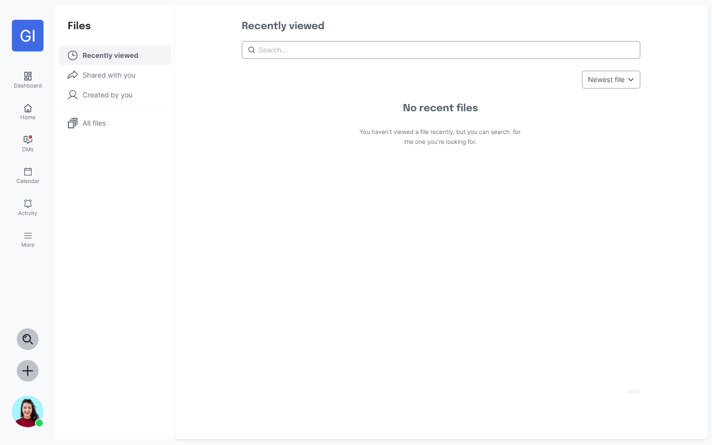
UI Design – Files

Slide 27
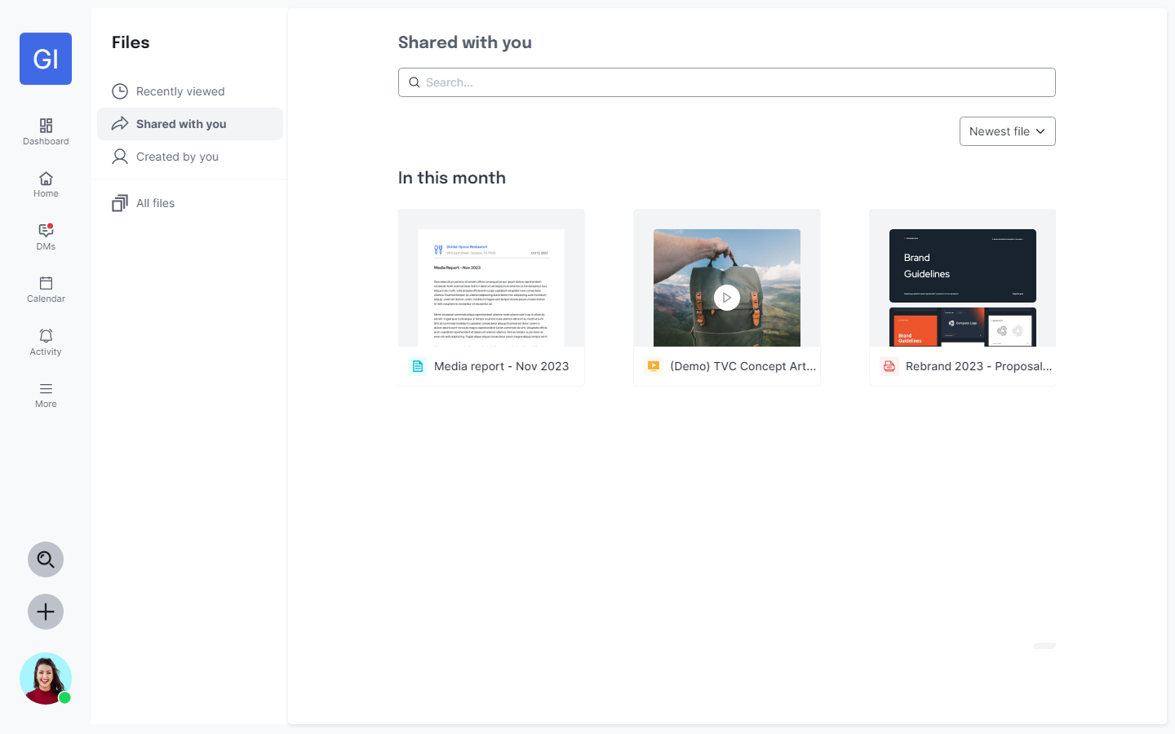
UI Design – Files

Slide 28
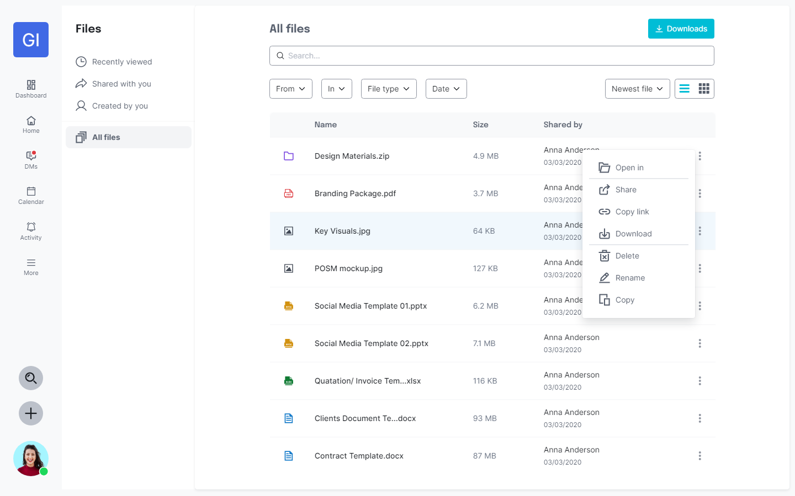
UI Design – Files

Slide 29
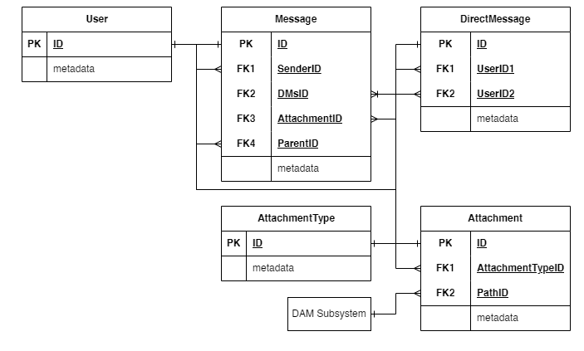
Database Entity – Files

Slide 30
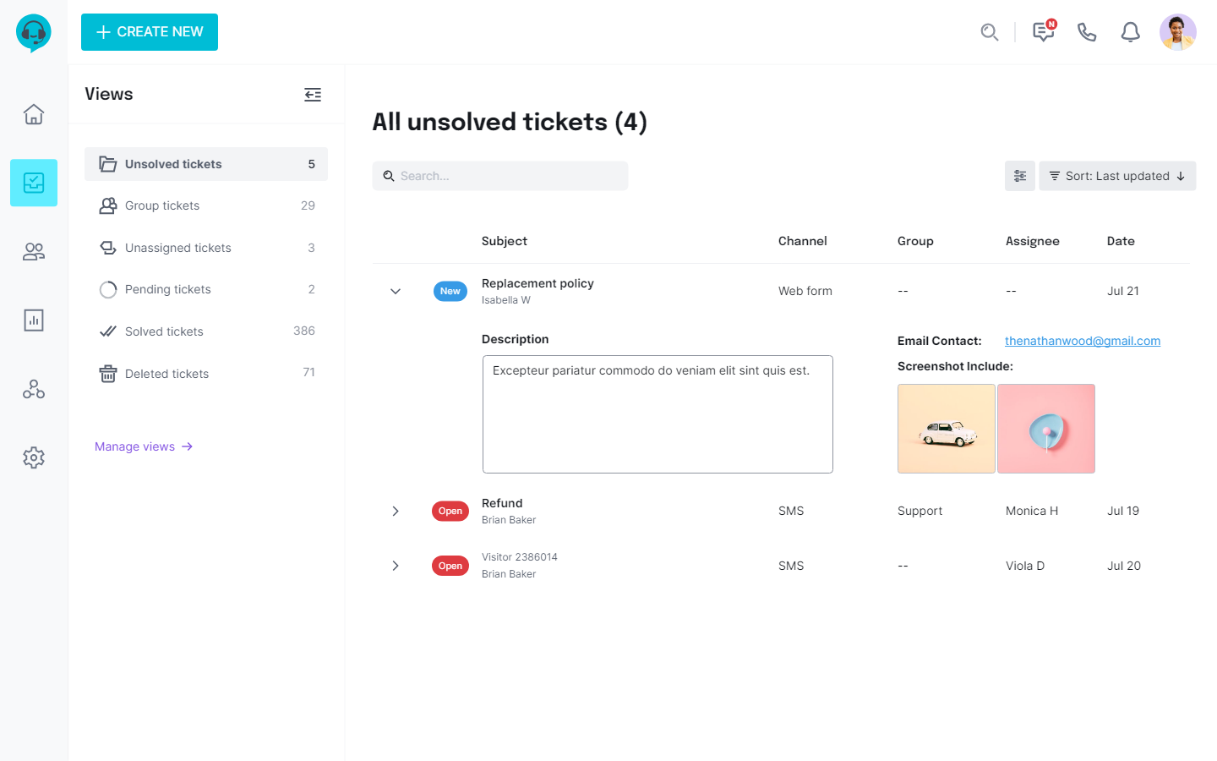
UI Design – Manage ticket

Slide 31
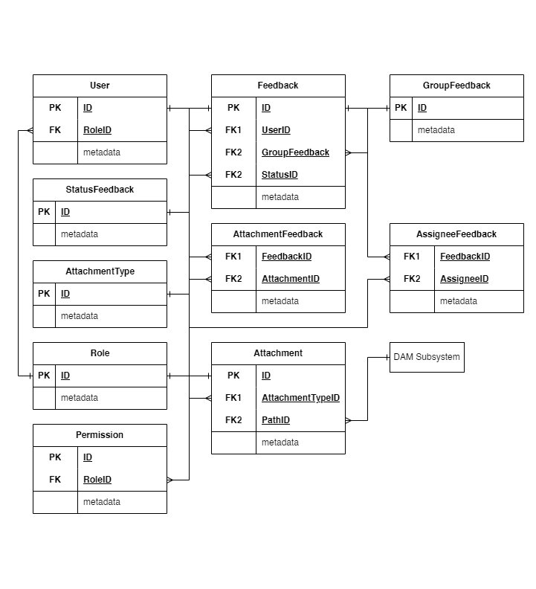
Database Entity – Manage Ticket

Slide 32
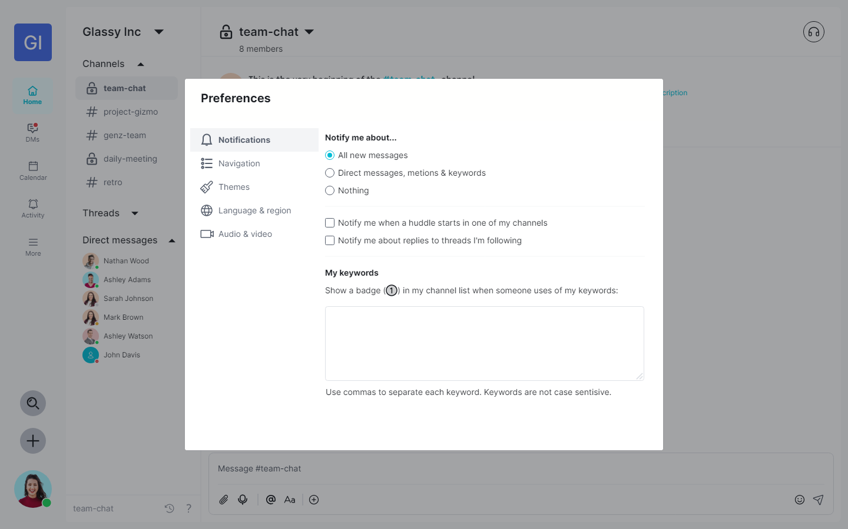
UI Design – Preferences

Slide 33
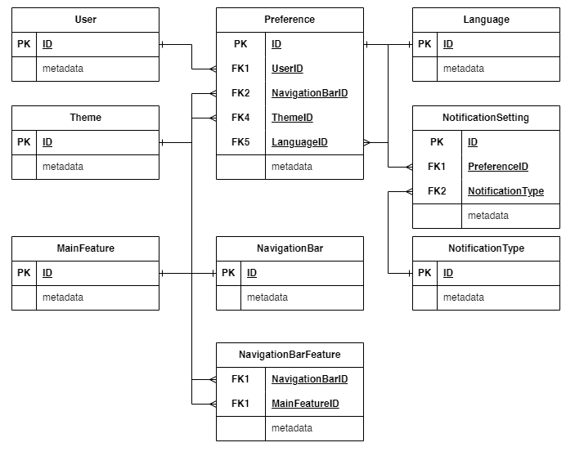
Database Entity – Preferences

Slide 34
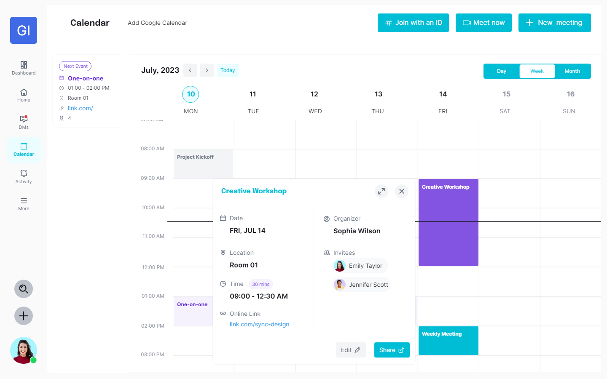
UI Design – Calendar

Slide 35
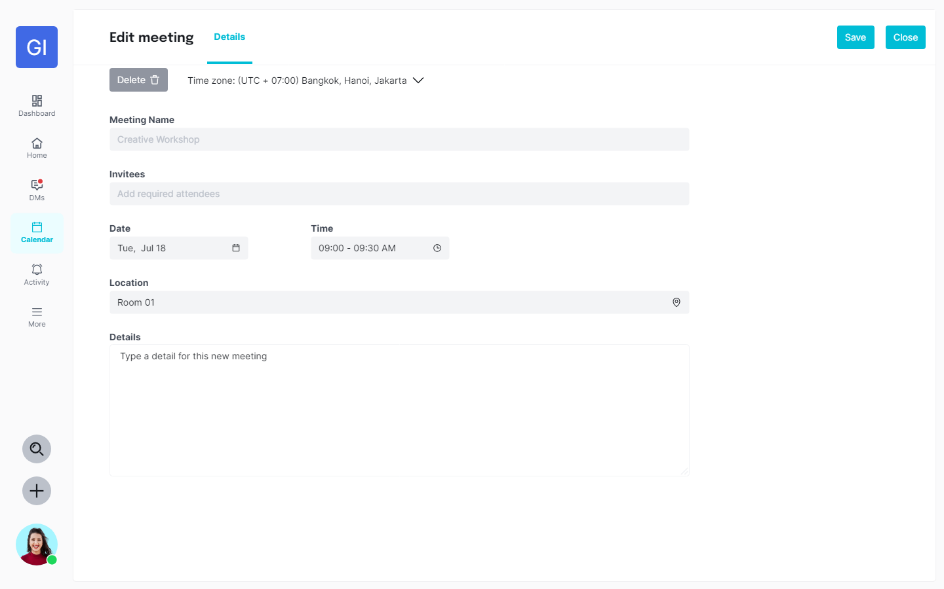
UI Design – Calendar

Slide 36
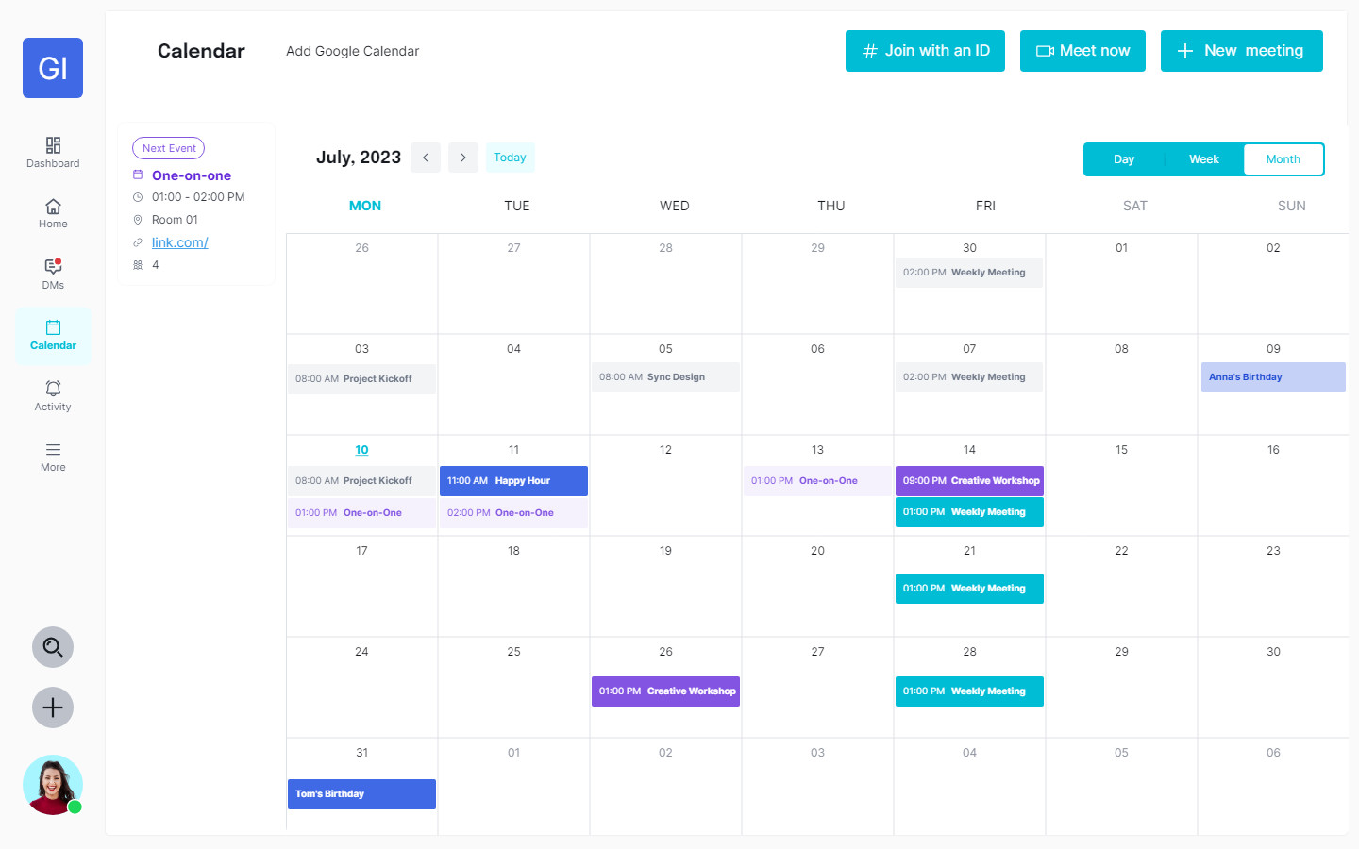
UI Design – Calendar

Slide 37
Database Entity – Calendar

Slide 38
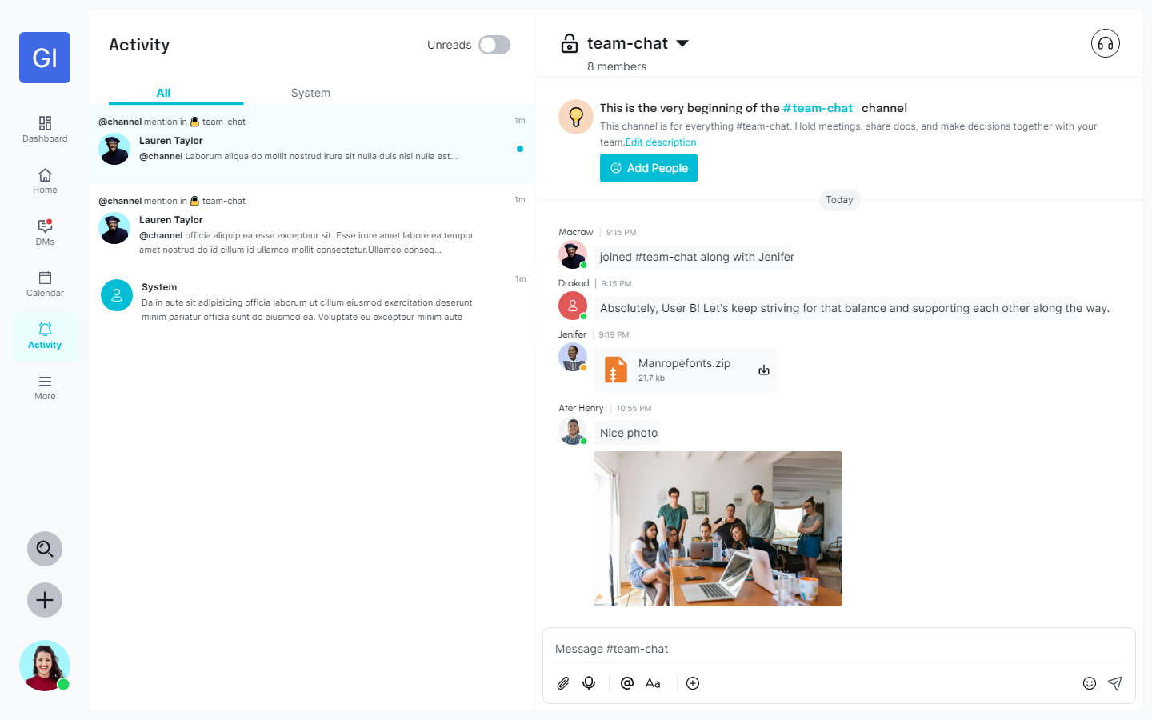
UI Design – Activity

Slide 39
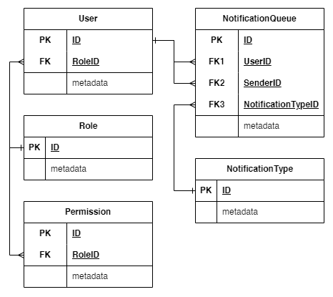
Database Entity – Activity

Slide 40
QUESTIONS AND ANSWERS
Q&A
THANK YOU
FOR YOUR TIME

Slide 41
THANK YOU FOR YOUR TIME
THANK YOU
FOR YOUR TIME

